Slide 1
Carbohydrates

Slide 2
Definition:
Organic compounds composed of C, H and O with H and O present in the same ratio as in water.
    E.g. Glucose C₆H₁₂O₆.
Exceptions:
  Deoxy sugars such as Rhamnose C₆H₁₂O₅, digitoxose C₆H₁₂O₄
  Some non carbohydrates follow the definition:
        Acetic acid C₂H₄O₂
        Formaldehyde HCHO
        Lactic acid C₃H₆O₃
New definition:
Optically active Polyhydroxy aldehydes or ketones, or substances that hydrolyze to yield polyhydroxy aldehydes or ketones.

Slide 3
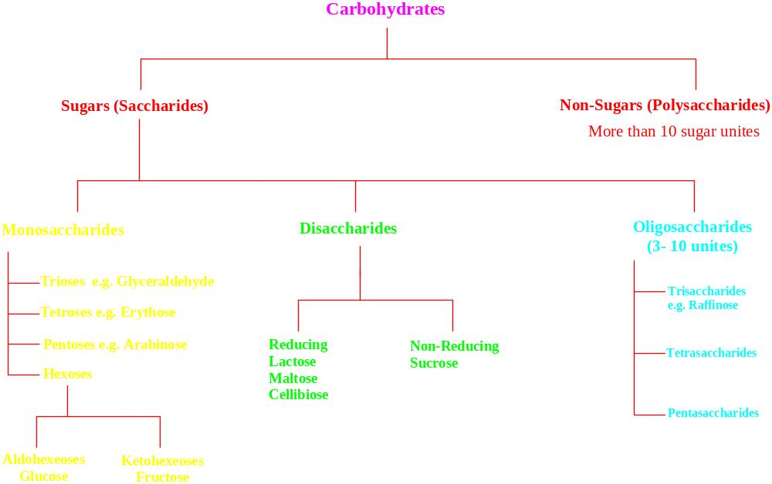

Slide 4
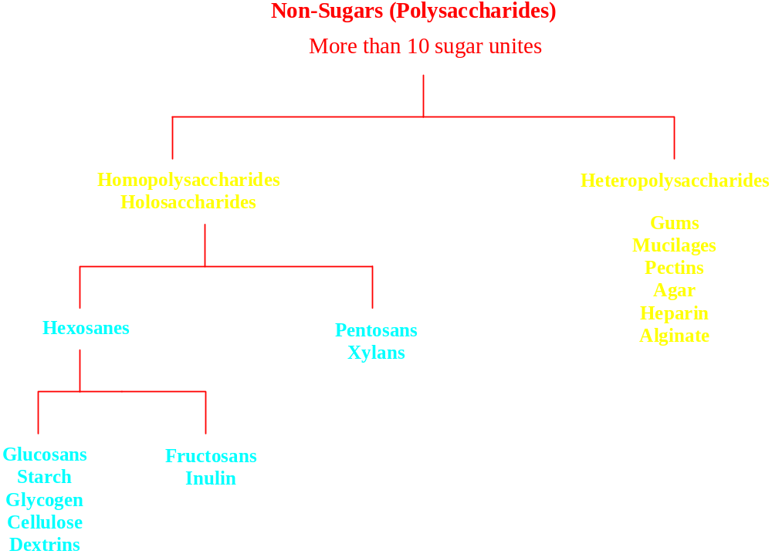

Slide 5
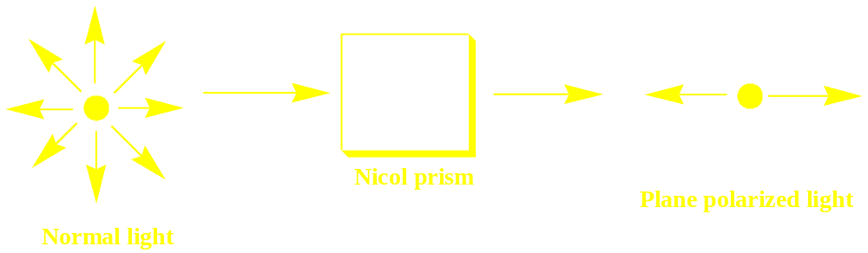
Optical activity:
A compound is optically active when, in solution, it is capable to rotate the plane of polarized light either to right or clockwise (dextrorotatory, + or d) or to the left (anti-clockwise)(levorotatory, - or l).
The optical activity of a compound is measured by determination of its specific optical rotation ([α] _{D}^{t}) (which is characteristic value for every optically active compound) using a polarimeter, and applying the following equation:
[α]_{D}²⁵ = α /LC
Where: α = Observed rotation (vary according to variation in conc and length of sample tube),
L = length of tube (light path) in decimeter,
C = concentration g /ml,
25 = operating temperature (t) in ⁰C,
D = line spectrum of light (589 nm).

Slide 6
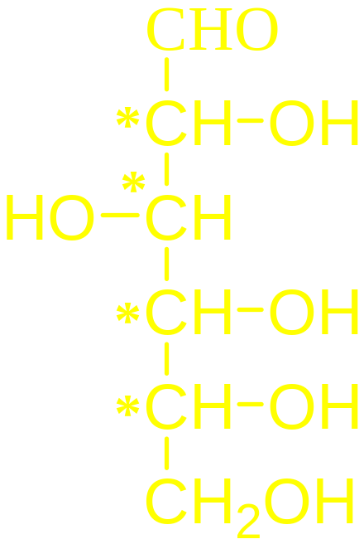
Sugar isomers:
Hexoses like glucose have 4 asymmetric (chairal) carbons.
Number of isomers can be calculated from the formula:
Number of isomers = 2^{n}
= 2⁴ = 16

Slide 7
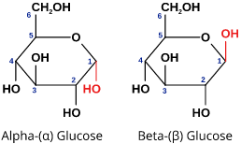
α- and β- anomers of glucose:
When sugars under go cyclization C-1 became a new chairal carbon and two isomers exist. They are called “ Anomers”.
In the α-anomer the OH group is directed downside and in the β-anomer is directed to the upper side.
These two forms have different specific rotation, in solution an equlibrium exsit between the two forms (mutarotation phenomenon).

Slide 8
Mutarotation
When a sugar is dissolved in water, the specific rotation of the solution gradually changes until it reaches to a constant value due to equilibrium between the α and β forms.
e.g. freshly prepared solution of β -glucose has a specific rotation +112º. When this solution is allowed to stand the rotation falls till reach + 52.7º.

Slide 9
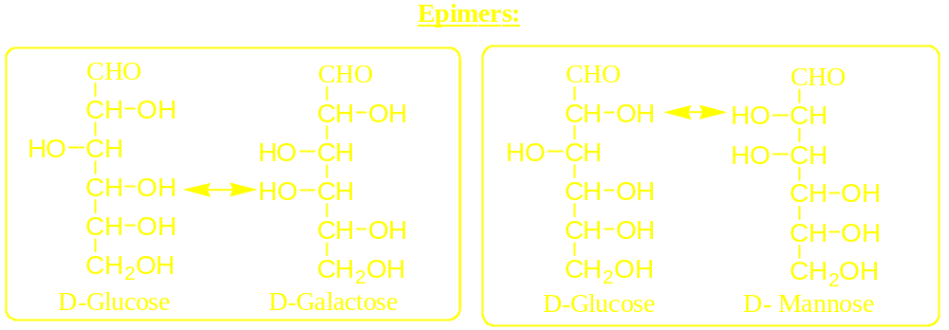
Terms used to describe isomerism in carbohydrates:
Glucose and Galactose are different from each other in the stereochemistry of carbon 4. They are described as “Epimers”.
Glucose and Mannose are different from each other in the stereochemistry of carbon 2. They are described as “Epimers”.

Slide 10
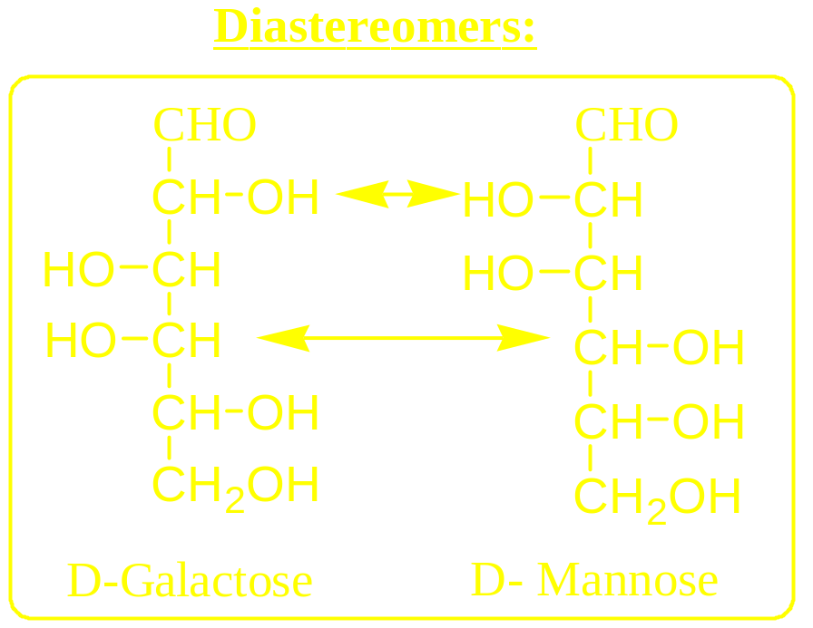
Galactose and Mannose are different from each other in the stereochemistry of carbons 2 and 4. They are described as “Diastereoisomers””Diastereomers”.

Slide 11
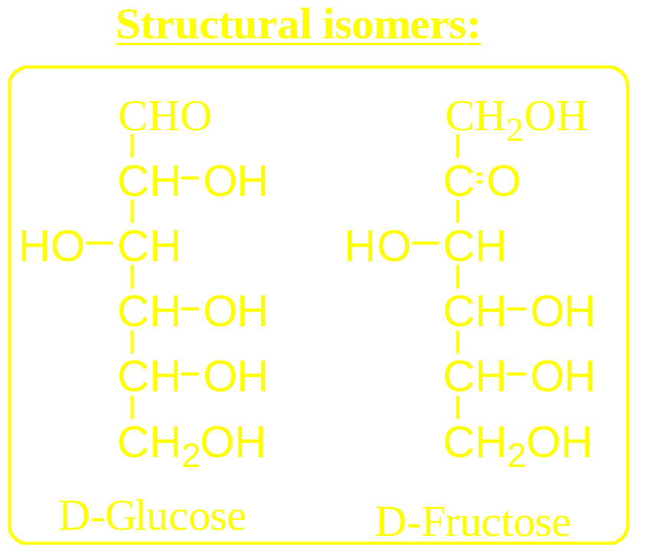
Glucose and Fructose have the same molecular formula C₆H₁₂O₆. They have different structures with different function groups. They are described as “Structural Isomers”.

Slide 12
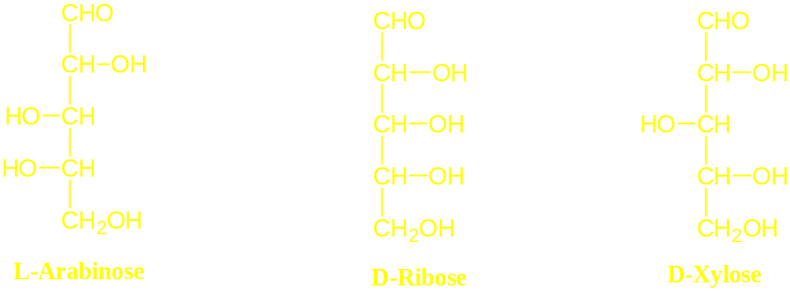
Pentoses
Examples:
α-D-Ribose: found in all plant and animal cells as the carbohydrate part of nucleic acids e.g. ribonucleic acid (RNA).
α-D-Xylose (or wood sugar): prepared from corncobs, bran, straw (or any woody material) by boiling with acids, fermenting out any glucose present with yeast, and crystallizing the D-xylose from the evaporated solution.
α-L-Arabinose (or pectin sugar): found in gums, pectic substance and with hemicelluloses and forms the sugar part of several glycosides.

Slide 13
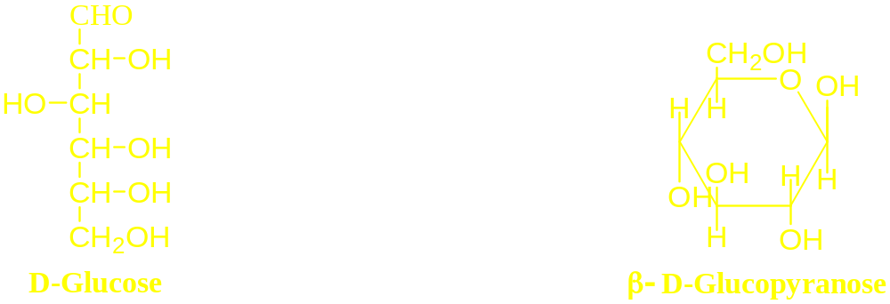
Hexoses
1- α-D-Glucose
(dextrose, grape sugar, blood sugar)
Occurrence:
Widely distributed in nature. Present in Grape and blood.
Preparation:
D-Glucose is commercially prepared from starch by:
Autoclaving (at 150 0C) an aqueous starch suspension (15-20%) with dilute acid (0.03 N hydrochloric acid) for 30 minutes (complete hydrolysis).

Slide 14
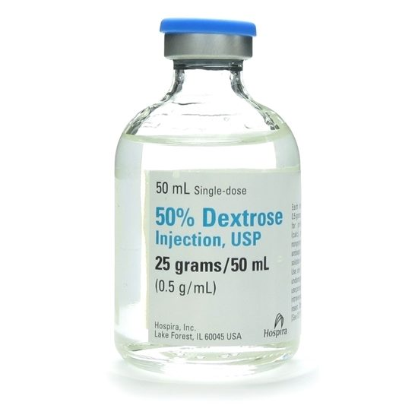
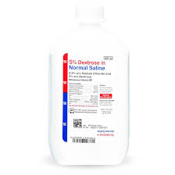
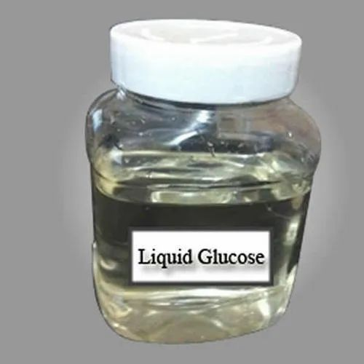
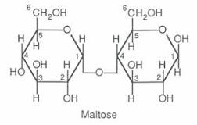

Slide 15
Uses:
    As source of energy either by mouth or IV injection.
    IV solutions to restore blood volume.
    Shocks following insulin administration.
    As osmotic diuretic.
    Sweetening agent for Pharmaceutical preparations
Liquid glucose:
  Preparation:
    It is prepared by partial acid hydrolysis of starch using dilute hydrochloric acid and heating for 20 minutes at about 30 pounds pressure.
  Composition:
    It consists of a mixture of glucose, dextrin, maltose and water.
  Uses:
    Used as sweetening agent, as substitute for sucrose and as an excipient in pills.

Slide 16
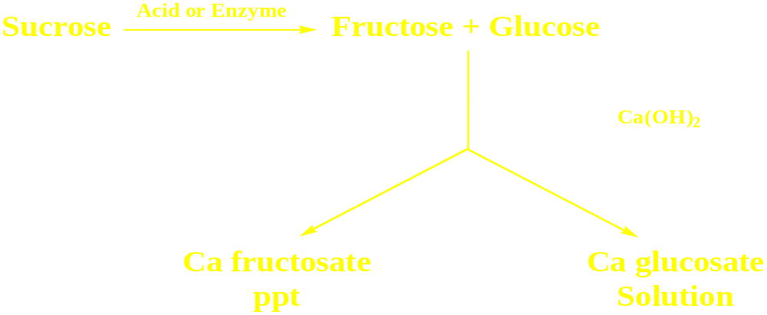
2- Fructose
(Levulose, Fruit Sugar)
Is the only naturally occurring ketohexose . It is also referred to as levulose because it has an optical rotation that is strongly levorotatory
Preparation:
    Acid hydrolysis of Inulin.
    Hydrolysis of Sucrose.

Slide 17
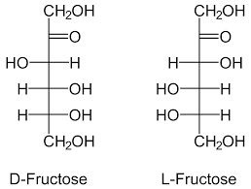
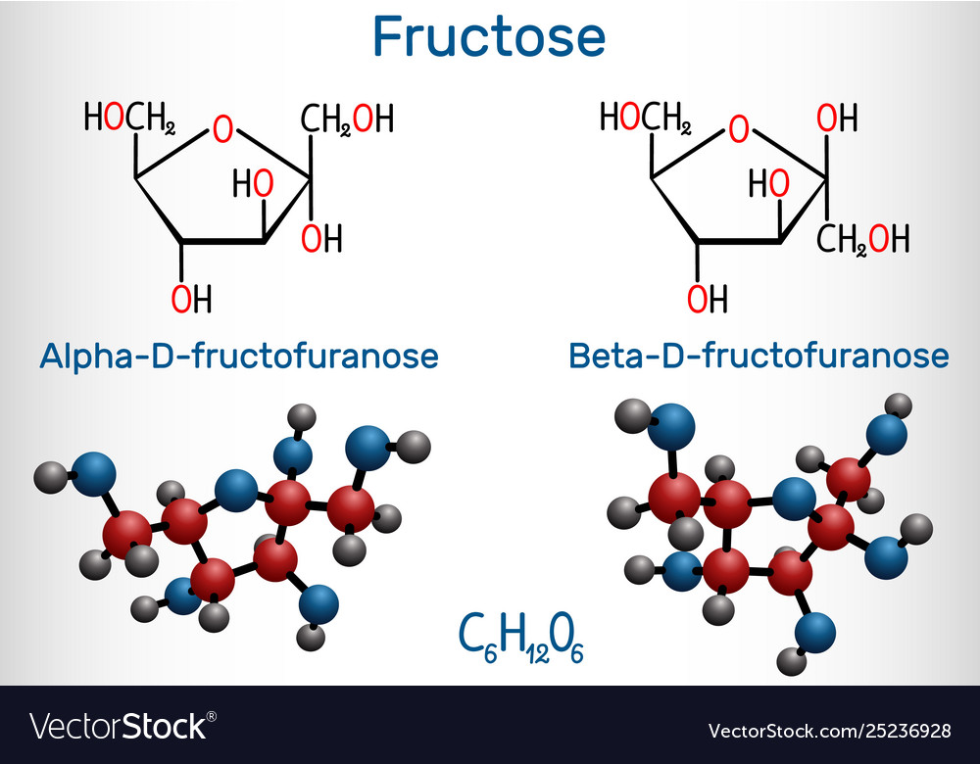
Uses:
    Infant food.
    Diabetic food.
    Diet control.

Slide 18
Some Monosaccharide derivatives in Pharmacy and Medicine
Gluconic acid and its salts:
      Preparation:
Gluconic acid is prepared from glucose by mild oxidation using either dilute HNO₃ or Br₂/Na₂CO₃ or by fermentation using Acetobacter aceti.
      Uses:
Ca gluconate is used (by i.v. or orally) for treatment calcium deficiency.
Ferrous gluconate, (orally or by i.v.) is used in iron deficiency.
These salts are characterized by being more easily absorbed than other Ca or Fe salts.

Slide 19
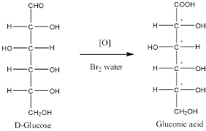
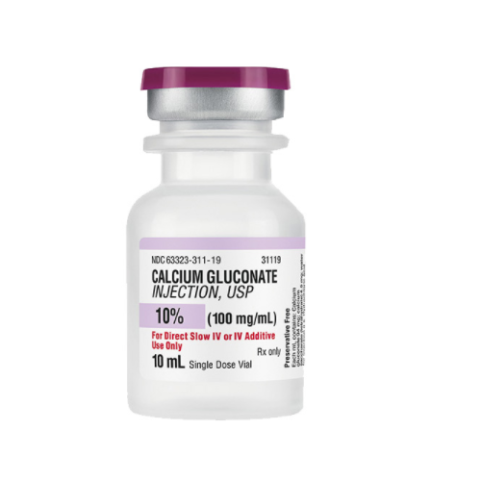
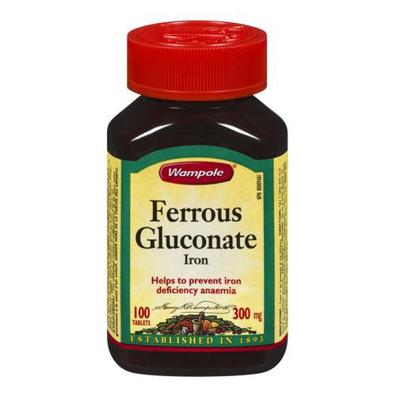
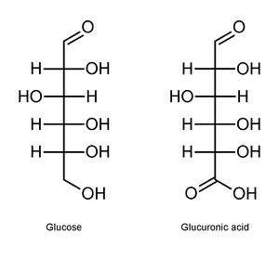
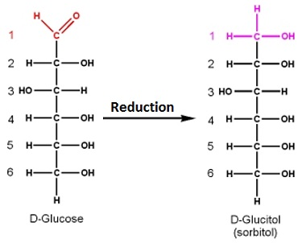
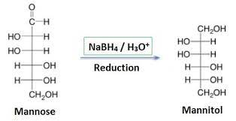
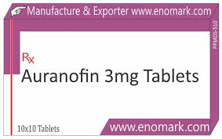

Slide 20
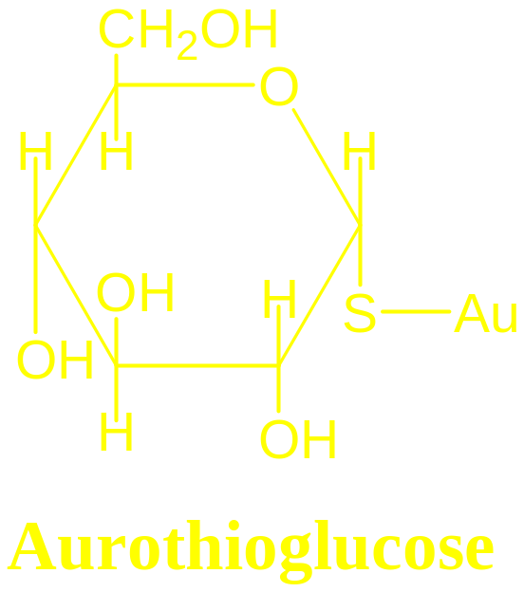
Glucuronic Acid:
  Naturally present in Gums and Mucilage's. It can be prepared by Enzymatic oxidation of glucose.
  Uses:
      Treatment of certain arthritic condition as it is a component of cartilages, joint fluids, nerve sheath and tendons.
Aurothioglucose:
    Treatment of rheumatic arthritis by IM injection.

Slide 21
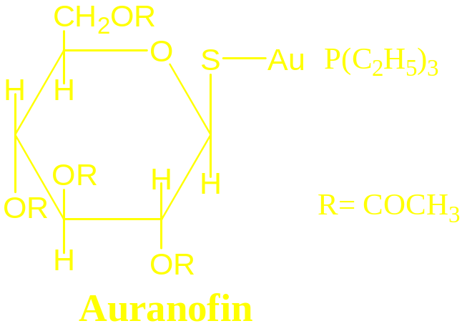
Auranofin:
    It is the alkyl Phosphine Gold complex with Acetylated thioglucose.
    Treatment of rheumatic arthritis orally.
Sorbitol and Mannitol:
  Preparation:
    Sorbitol is prepared by reduction of glucose and mannitol by reduction of mannose.
  Uses:
    Sorbitol is used as a mild laxative, in preparation of spans and tweens, sweetening agent, osmotic diuretic and in some food and cosmetics industries.
    Mannitol is used as an osmotic diuretic, laxative, , vasodilator (mannitol hexanitrate), antineoplastic (mannitol- (mannitol hexanitrate) and in laboratory diagnosis of kidney function.

Slide 22
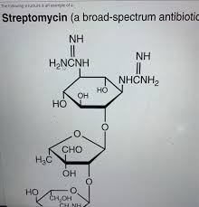
Carbohydrate Antibiotics
One of the important discoveries in carbohydrate chemistry was the isolation of the carbohydrate antibiotic called streptomycin.
Streptomycin is made up of three unusual components.
The glycosidic linkage is nearly always α .

